Slide 1

IT Projects Management 1100-ZP0UEN Information technology laboratory (LI) Winter Semester 2023/2024
2023/12/12

Slide 2
What is project scope management?
Project scope management is the process to ensure that a particular project includes all the work relevant/appropriate to achieve the project’s objectives.

Slide 3
Project Scope Management consists of three processes
Planning: The process of getting an overview and defining the work that needs to be done to achieve the deliverables is called Planning.
Controlling: The process of documenting, tracking, focusing on scope disruption, and also continually approving and disapproving the project changes through the controlling and monitoring process is called controlling.
Closing: The process that includes an examination of the project deliverables and an assessment of the outcomes of the project against the original plan is the primary function of Closing.

Slide 4
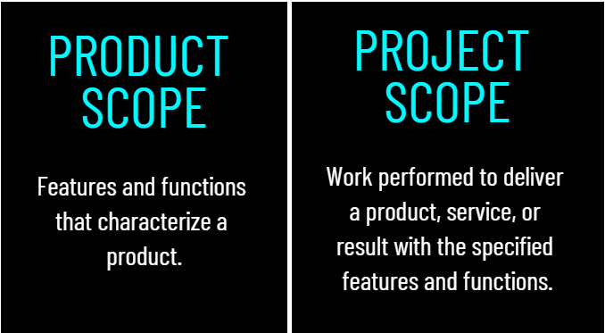
Product Scope: Product scope can be defined as the features or characteristics of a product regardless of the design, function, or parts, and the critical point is that product scope refers to the actual tangible product that is finally produced.
Project Scope: In contrast to product scope, project scope focuses on the various steps taken to deliver a product. Project scope can include things like assembly lines, budgets, staff training, supply chains, and personnel allocations.

Slide 5
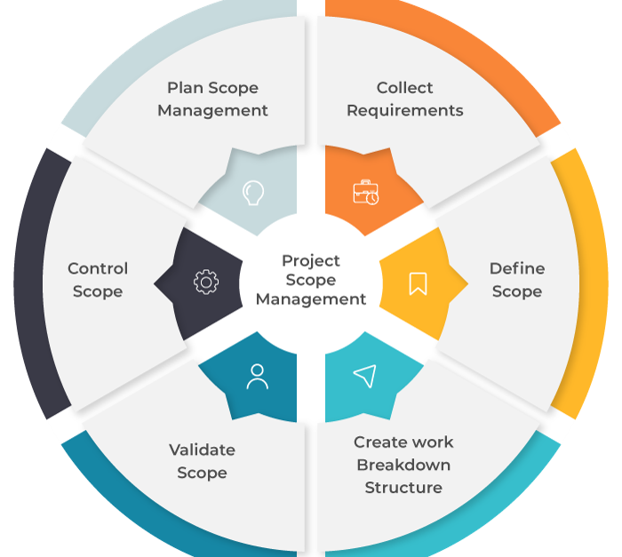

Project Scope Management Process
Project Scope Management Process is consisting of six processes

Slide 6
Plan Scope Management
The scope management plan describes the project scope and documents how it will be further defined, validated, and controlled throughout the lifecycle of the project.
The scope management plan includes the following:
Project Scope Statement
Project Requirements
Project Deliverables
Work breakdown schedule and change control process

Slide 7
Collect Requirements
It is the process of defining and documenting stakeholders’ needs to meet the project activities.
The document for collecting requirements is developed in the project planning phase.
The “collect requirements” process includes the following:
Business Requirements
Stakeholder’s Requirements
Project Requirements
Quality Requirements
Support and Training Requirements

Slide 8
Define Scope
This is the process of developing a detailed description of the project and product, while collecting the requirement list. all the different requirements of the project and the resulting product or service are defined.
The following are included while defining the scope:
Project goals and objectives
Tasks in the project
Resources
Budget and Schedule, etc

Slide 9
Create Work Breakdown Structure
Creating a work breakdown structure is done using a technique called decomposition/breakdown.
It is the process of subdividing project deliverables and project work into smaller and more manageable components for achieving a better outcome.
Creating the work breakdown structure includes the following:
Project Management plans, documents, enterprise environmental factors, organizational structure, etc.
Decision-making and breakdown of tasks for the project deliverables into smaller activities.
Scope baseline and updates made to the project document.

Slide 10
Validate Scope
A part of the project monitoring and control process group in which process includes reviewing deliverables with the customer or sponsor to ensure that they are completed satisfactorily and obtaining formal acceptance of deliverables by the customer or sponsor.
The following are included while validating the scope:
Completion of project deliverables
Acceptance of project deliverables
If the requirements are being met for the project deliverables

Slide 11
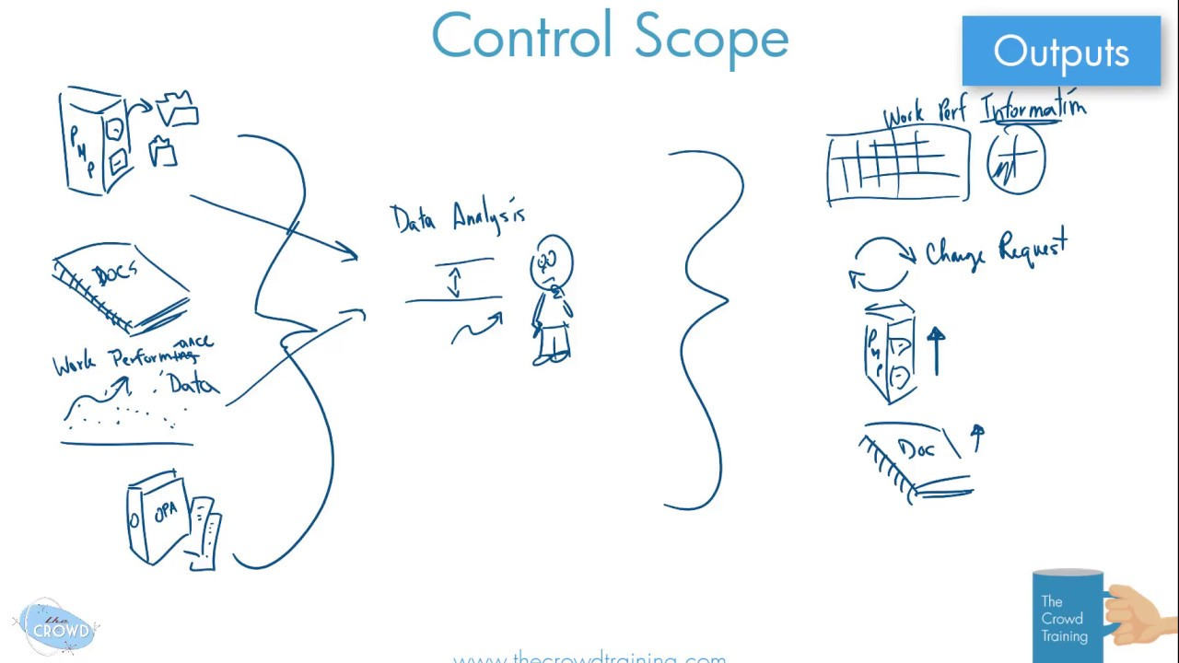
Control Scope
Control scope is the last process group in project scope management. It is again a part of the project monitoring and control process group. Control scope is the process of monitoring the status of the project and product scope and managing changes to the scope baseline.

Slide 12
A work breakdown structure (WBS)
A work breakdown structure (WBS) is a visual, hierarchical and deliverable-oriented deconstruction of a project. It is a helpful diagram for project managers because it allows them to break down their project scope and visualize all the tasks required to complete their projects.

Slide 13
Why Use a WBS In Project Management?
Making a WBS is the first step in developing a project schedule. It defines all the work that needs to be completed (and in what order) to achieve the project goals and objectives.
A well-constructed work breakdown structure helps with important project management process groups and knowledge areas such as:
Project Planning, Project Scheduling and Project Budgeting
Risk Management, Resource Management, Task Management and Team Management

Slide 14
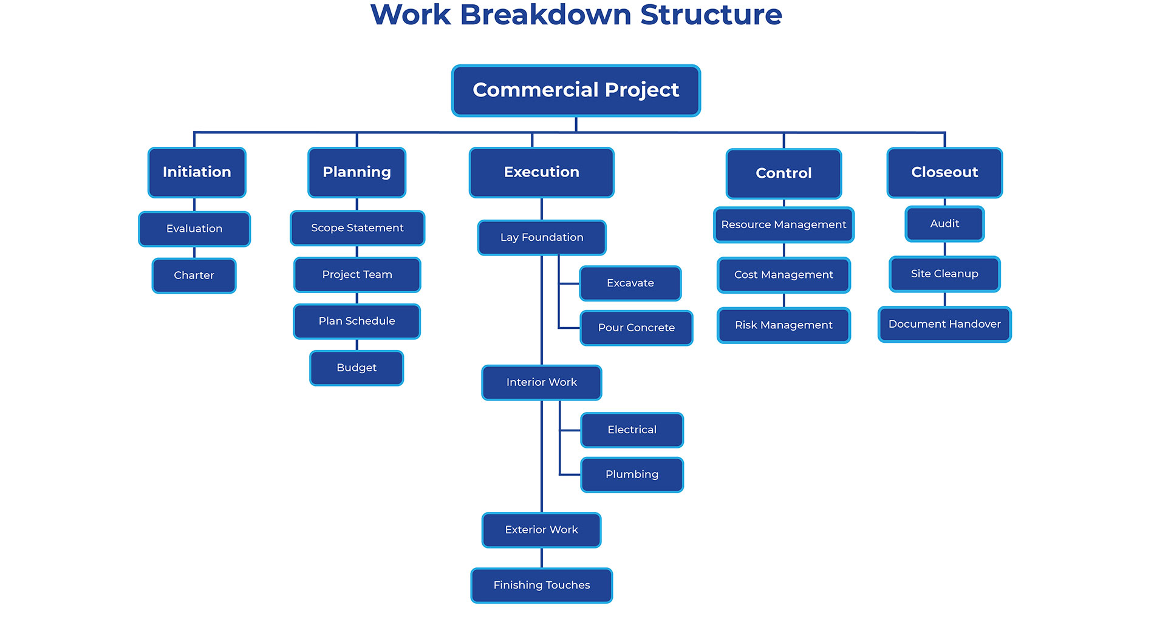
Work Breakdown Structure Example
work plan for a commercial building construction project

Slide 15
Types of WBS
There are two main types of WBS:
Deliverable-based, and phase-based. They depend on whether you want to divide your project in terms of time or scope.

Slide 16
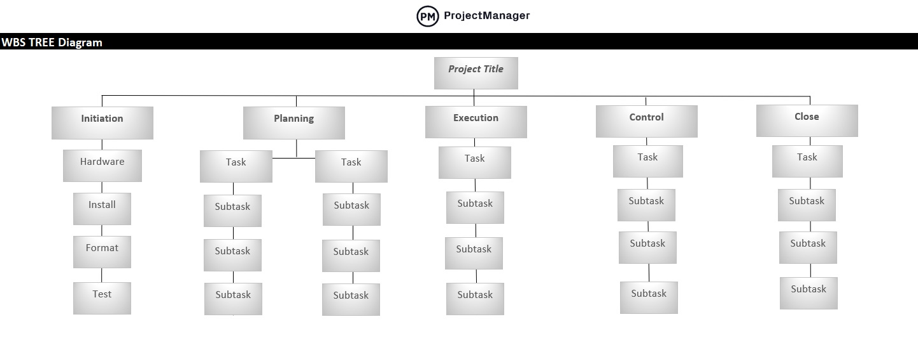
Deliverable-Based Work Breakdown Structure
A deliverable-based WBS first breaks down the project into all the major areas of the project scope as control accounts, and then divides those into project deliverables and work packages

Slide 17
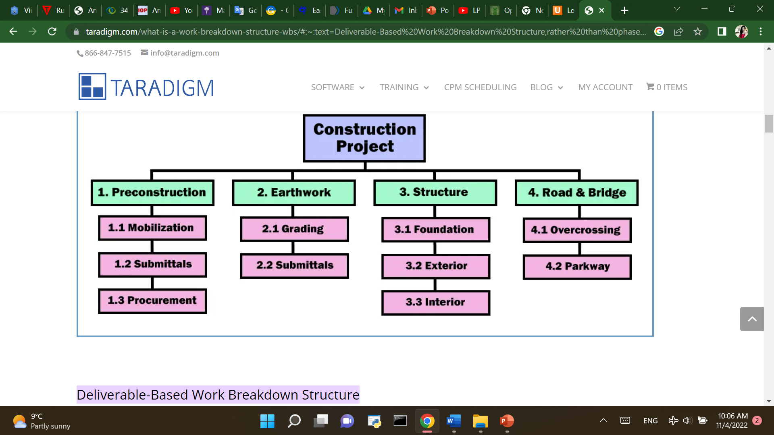
Phase-Based Work Breakdown Structure
The phase-based WBS displays the final deliverable on top, with the WBS levels below showing the five phases of a project (initiation, planning, execution, control and closeout). Just as in the deliverable-based WBS, the project phases are divided into project deliverables and work packages.

Slide 18
Types of WBS Charts
Work Breakdown Structure List: Also known as an outline view, this is a list of work packages, tasks and deliverables. It’s probably the simplest method to make a WBS, which is sometimes all you need.
Work Breakdown Structure Tree Diagram: The most commonly seen version, the tree structure depiction of a WBS is an organizational chart that has all the same WBS elements of the list (phases, deliverables, tasks and work packages) but represents the workflow or progress as defined by a diagrammatic representation.
Work Breakdown Structure Gantt Chart: A Gantt chart is both a spreadsheet and a timeline. The Gantt chart is a WBS that can do more than a static task list or tree diagram. With a dynamic Gantt chart, you can link dependencies, set milestones, even set a baseline.

Slide 19
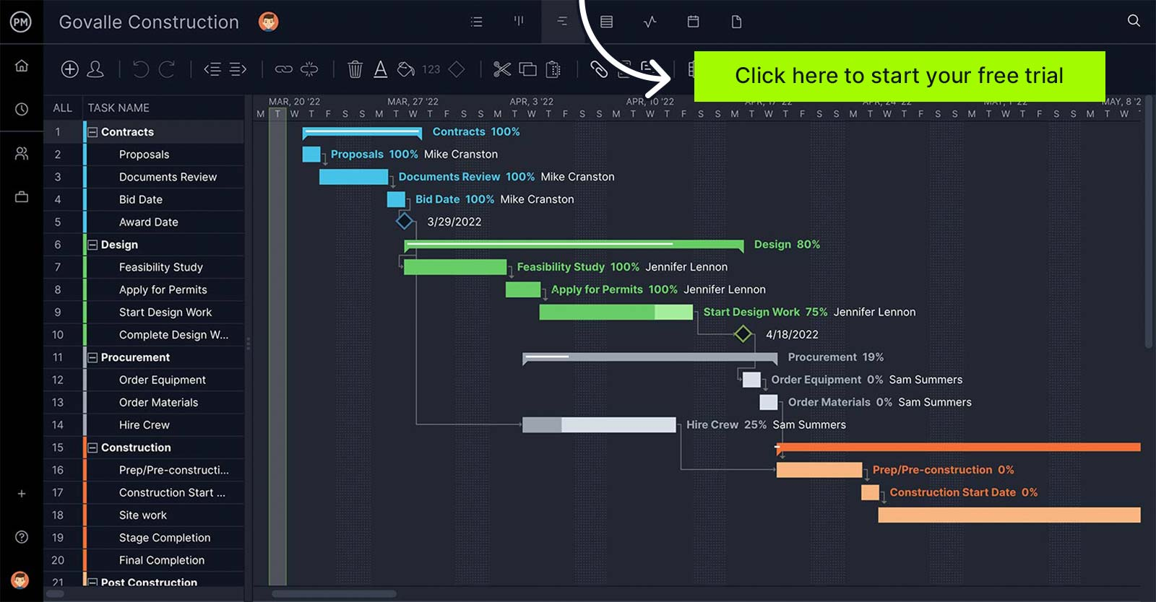

Slide 20
WBS Elements
WBS Dictionary: A WBS dictionary is a document that defines the various WBS elements.
WBS Levels: The WBS levels are what determines the hierarchy of a WBS element.
Control Accounts: Control accounts are used to group work packages and measure their status. They’re used to control areas of your project scope.
Project Deliverables: Project deliverables are the desired outcome of project tasks and work packages.
Work Packages: A work package is the “lowest level of the WBS”. That’s because a work package is a group of related tasks that are small enough to be assigned to a team member or department.
Tasks: Your tasks make up your work packages and therefore, your project scope. A WBS will help you define each task requirements, status, description, task owner, dependencies, and duration.

Slide 21
How to Create a Work Breakdown Structure In Six Steps
Define the Project Scope, Goals and Objectives :Your project goals and objectives set the rules for defining your project scope.
2. Identify Project Phases & Control Accounts : break the larger project scope statement into a series of phases that will take it from conception to completion.
3. List Your Project Deliverables : What are your project deliverables? List them all and note the work needed for those project deliverables to be deemed successfully delivered (sub-deliverables, work packages, resources, participants, etc.)
4. Set WBS Levels : The WBS levels are what make a work breakdown structure a “hierarchical deconstruction of your project scope”.
5. Create Work Packages : Take your deliverables from above and break them down into every single task and subtask that is necessary to deliver them. Group those into work packages.
6. Choose Task Owners : With the tasks now laid out, assign them to your project team. Give each team member the work management tools, resources and authority they need to get the job done.

